Slide 1


February 2025
Category review: Chips
Retail Data
Analytics
1
Classification: Confidential

Slide 2
Our 17 year history assures best practice in privacy, security and the ethical use of data
We all have a responsibility to use data for good
Privacy
Security
Ethical use of data
Applies to all facets of our work, from the initiatives we take on, the information we use and how our solutions impact individuals, organisations and society.
We have built our business based on privacy by design principles for the past 17 years
Quantium has strict protocols around the receipt and storage of personal information
All information is de-identified using an irreversible tokenisation process with no ability to
re-identify individuals.
We are ISO27001 certified - internationally recognised for our ability to uphold best practice standards across information security
We use ‘bank grade’ security
to store and process our data
Comply with 200+ security requirements from NAB, Woolworths and other data partners
All partner data is held in separate restricted environments
All access to partner data is limited to essential staff only
Security environment and processes regularly audited by our data partners.
Quantium believes in using data for progress, with great
care and responsibility. As such please respect the commercial in
confidence nature of this document.
2
Classification: Confidential

Slide 3
Executive summary
01
Chips Category Review
There is an increase in sales before Christmas and zero sales on Christmas day, this can serves as an advantage within the region.
Most frequent chip pack size purchased is 175g followed by 150g pack size for all segments.
The Mainstream category of Young and Mid-age Singles/Couples have the highest spending of chips per
purchase.
Young and Mid-age Singles/Couples is the only segment having Doritos as the highest purchase brand while Smiths is for other segments.
Mainstream young singles/couples are 27% more likely to purchase Twisties.270g pack of chips compared to the rest of the population.
Chips Brand Kettle is the most purchased brand in all stores.
02
Store Analysis
Trial stores 77 and 86 have significant increase in total sales and number of customers during trial as compared to control store.
Trial store 88 had increase as well but not as good as stores 77 and 86.

Slide 4
Category
01

Slide 5
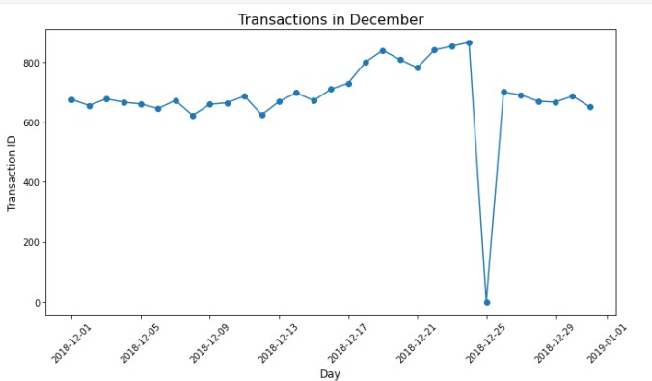
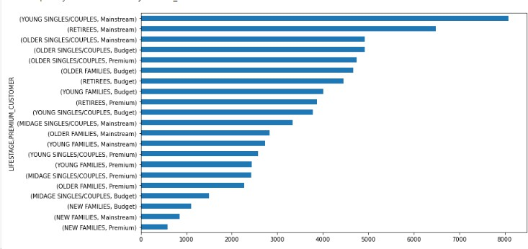
Customer category
Sales increase steadily as the Christmas day approaches and return again
to early December sales level
during New Year Eve.
Sales mainly came from Mainstream – young and older singles/couples, and Mainstream - retirees. In total contributing 25% of
sales revenue.

Slide 6
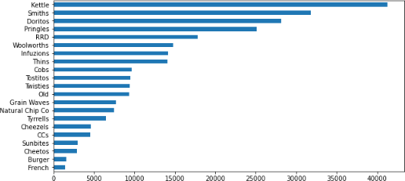
Consumer buying for the category of chips
Chips Brand Kettle is the most purchased brand in all stores.

Slide 7
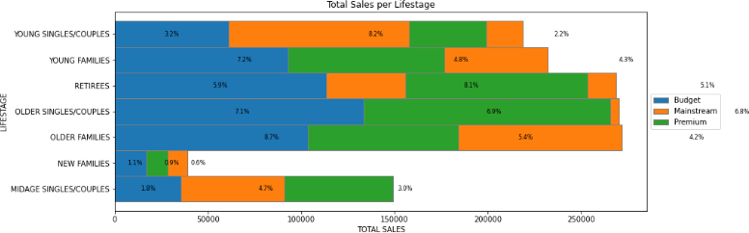
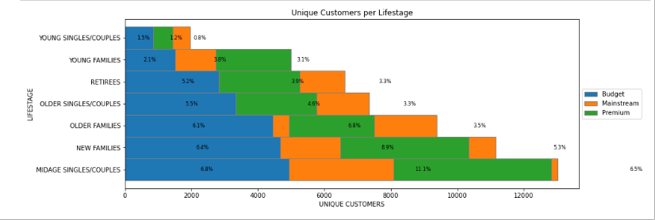
The proportion of customers by affluence and life stage
Sales mainly came from Budget - older families, Mainstream - young singles/couples, and Mainstream - retirees. In total contributing 25% of sales revenue.
Older and Young Family segment have the highest average purchase units per unique customer

Slide 8
02
Trial store performance

Slide 9
Control store vs other stores
In the context of this analysis, the terms "control store" and "other stores" are used to classify and compare different types of retail stores, typically in the context of a marketing or business evaluation. Control stores are used as reference points for comparison, while other stores provide additional context and data for a more comprehensive analysis of how specific changes or strategies affect the performance of retail stores. This approach helps businesses make informed decisions and understand the effectiveness of their actions.

Slide 10
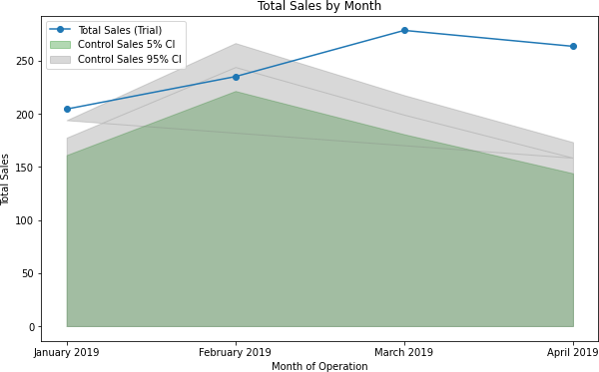
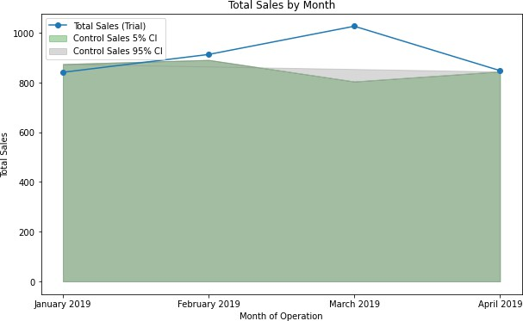
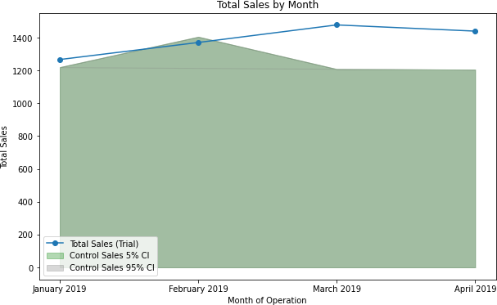
Performance of the trial store
We can see that Trial store 77 sales for Feb, March, and April exceeds 95% threshold of control store. Same
goes to store 86 sales for all 3 trial months.
Whereas trial store 88 sales is significantly different to its control store in the trial period as the trial store performance lies outside of the 5% to 95% confidence interval of the control store in two of the three trial months.
Trial Store 77 Trial Store 86 Trial Store 88
Trial Store 77: Control store 233
Trial store 86: Control store 155
Trial store 88: Control store 40
10
Overall the trial showed positive significant result

Slide 11
Disclaimer: This document comprises, and is the subject of intellectual property (including copyright) and confidentiality rights of one or multiple owners, including The Quantium Group Pty Limited and its affiliates (Quantium) and where applicable, its third-party data owners (Data Providers), together (IP Owners). The information contained in this document may have been prepared using raw data owned by the Data Providers. The Data Providers have not been involved in the analysis of the raw data, the preparation of, or the information contained in the document. The IP Owners do not make any representation (express or implied), nor give any guarantee or warranty in relation to the accuracy, completeness or appropriateness of the raw data, nor the analysis contained in this document. None of the IP Owners will have any liability for any use or disclosure by the recipient of any information contained in, or derived from this document. To the maximum extent permitted by law, the IP Owners expressly disclaim, take no responsibility for and have no liability for the preparation, contents, accuracy or completeness of this document, nor the analysis on which it is based. This document is provided in confidence, may only be used for the purpose provided, and may not be copied, reproduced, distributed, disclosed or made available to a third party in any way except strictly in accordance with the applicable written terms and conditions between you and Quantium, or otherwise with Quantium’s prior written permission
11

